Slide 1
Module 1
Introduction to Entrepreneurship for Smallholders
The values and opportunities

Slide 2
Module 1
This module lays the foundations for the goal of Sustainable Smallholders. This training programme is the start of your journey from your small holding to growth and sustainability. You will view your smallholding as an enterprise and the value and opportunities that lie within it. You will gain insight into your enterprise from different angles by using several tools that will support you on this entrepreneurial mission.
Module 1 concludes with your increasing understanding of the who – what – how of developing that all-important first business plan.
Introduction to this Project and the Importance of Smallholders
1
2
The Premium of Heritage Produce
3
Entrepreneurship Opportunities & Trialling your first product
4
Business Plan Development
5
Strengths, Weaknesses, Opportunities and Threats

Slide 3
01
Introduction to this Project and the Importance of Smallholders

Slide 4
Who Smallholders are and why they are so important?
According to The Food and Agriculture Organization (FAO) of the United Nations Smallholders are small-scale farmers, pastoralists, forest keepers, and fishers who manage areas of less than 10 hectares.
And you are a very important grouping.
Smallholders are key contributors to food security and nutrition
Your farms are typically better at promoting social equity and community well-being and have advantages in terms of environmental sustainability and addressing climate change. This in part derives from their greater attachment to local communities and landscapes, which foster a higher level of interest and care for the natural environment and climate upon which they rely for agricultural production.
Smallholders produce most of the food in many regions of the world and producing more food and nutrition in the world’s most populous, and food-insecure regions.

Slide 5

The Importance of Smallholders
About two-thirds of all farms in Europe are smallholders. Smallholder farmers sell their food locally, reducing the carbon footprint of the food. In addition, they grow a variety of crops, increasing both food diversity and biodiversity.
Although smallholder farms produce 80% of the world’s food supply, they only take up about 12% of the arable land. Source
Importantly, there is typically a respectful relationship between farmer and land, fostered by the use of local/traditional knowledge and farming techniques for crop and animal husbandry.

Slide 6
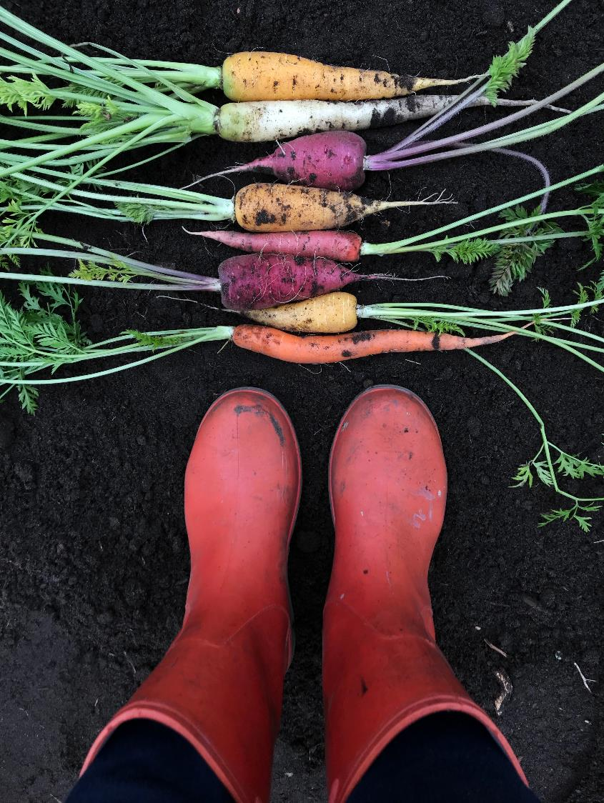
Smallholders hold the key to Europe’s agricultural & food heritage
Smallholders can be described as hard-working micro-businesses with a legacy product they believe in.
Despite crippling challenges and disadvantages due to the small size of their operations, weak technical capacity, high vulnerability to risks, and lack of capital, smallholders act like a seed bank, preserving our heritage breeds & rare arable crops
As a result, smallholder farming is about a third less productive than large-scale farming (UN Food and Agriculture Organisation).

Slide 7
This Project…
What you can achieve…
The Sustainable Smallholders EU project wants empower and equip smallholders like you with skills and knowledge improve your smallholding as a business.
Our Guidebook to Sustainable Development focuses on the latter two actions.
In this training course, we focus on the business side of your smallholding and how to help you grow as an enterprise.
1
Future proof your smallholdings: improving your long-term viability & use of the heritage value of your produce/livestock as your USP
2
Increase your profitability via: the use of more efficient and lucrative distribution channels & learning how to respond to consumer demands
3
Improve your ongoing environmental, climate action, and biodiversity work by focusing on your approaches to food security, food waste; and sustainable agriculture
4
Increase and diversify the way you contribute to food demand in a resource-scarce world

Slide 8
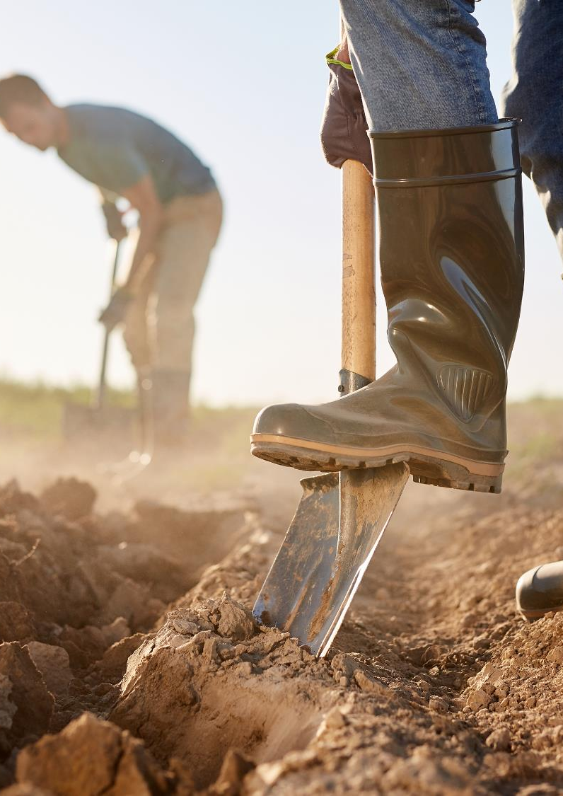
The motivation for providing this course…
Passionate and talented, smallholders are known to be exceptionally good at what they do – producing/breeding/growing artisanal produce rooted in the land and local communities with strong ethical, environmental, and heritage values.
This course will help smallholders gain new insights into basic entrepreneurial skills and how to embrace and market the local/heritage value of their produce. This course aims to give confidence and tools to address this clear need.

Slide 9
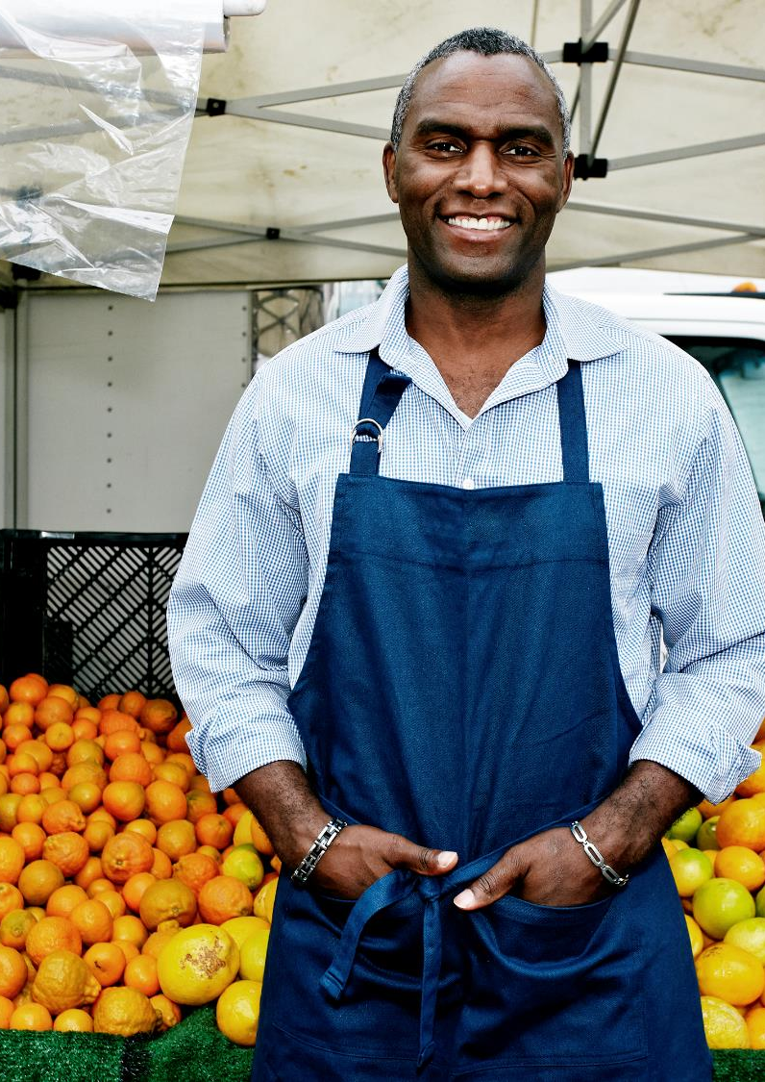
The motivation for providing this course…
Secondly, this course will equip you as smallholders (and those who educate/support you) with skills and knowledge to improve the viability of their holdings by championing the local/heritage value of their produce and improving their other basic entrepreneurial skills such as business planning, financial literacy, marketing, and sales.
In a step-by-step learning experience, you will benefit from and enjoy our sector-specific training modules. We built each module by rigorously researching and testing them and now we are presenting this 6-part course for smallholders like you! We know you will enjoy.

Slide 10

What this course aims to achieve…
“
Facilitate smallholders with tailored and targeted resources to help you to increase your bottom line and make your smallholding become more visible as a business and therefore become more sustainable
”

Slide 11
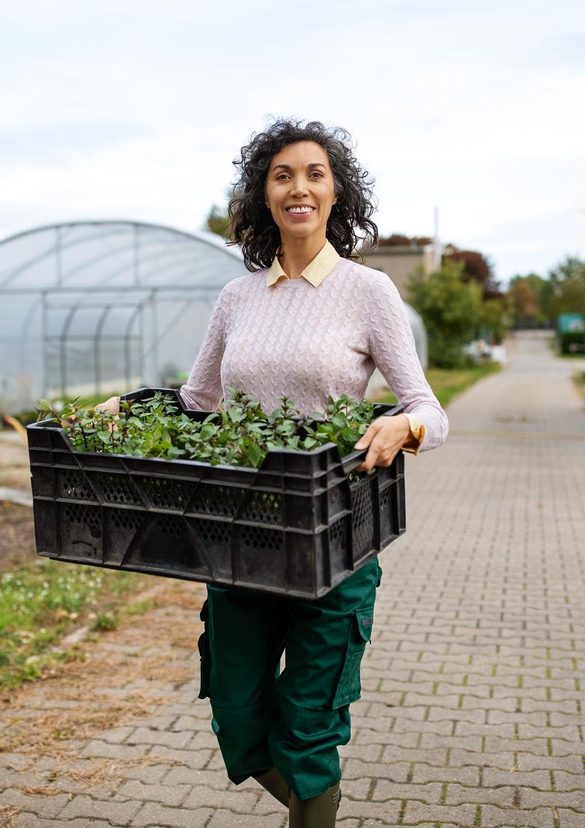
We have already described what SMALLHOLDERS are but they are also ENTREPRENEURS.
1. An entrepreneur is a starter: an initiator, a challenger, and a driver. Someone that creates something new, either an initiative, a business or a smallholding.
2. An entrepreneur is the driver: the person in charge, the leader, and the person to look to for leadership. He or she is the one that pushes forward and inspires a team or followers.
3. An entrepreneur is accountable and responsible: the ultimate person responsible for the destiny of their venture, which can be a smallholding, small scale farm, a project, or any other endeavor.

Slide 12

Student / learner Reflection:
Before we continue, let’s complete and exercise. Open a new document or take a pen and paper and make some notes.
Now is a good time to:
Reflect on your needs, aspirations and wants for your smallholding in the short, medium and long-term. Just some headlines.
Identify your individual and team strengths (if applicable)
Believe in your ability to influence the course of events toward sustainability and despite uncertainty, setbacks and failures along the way.

Slide 13
02
The Premium of Heritage Products

Slide 14
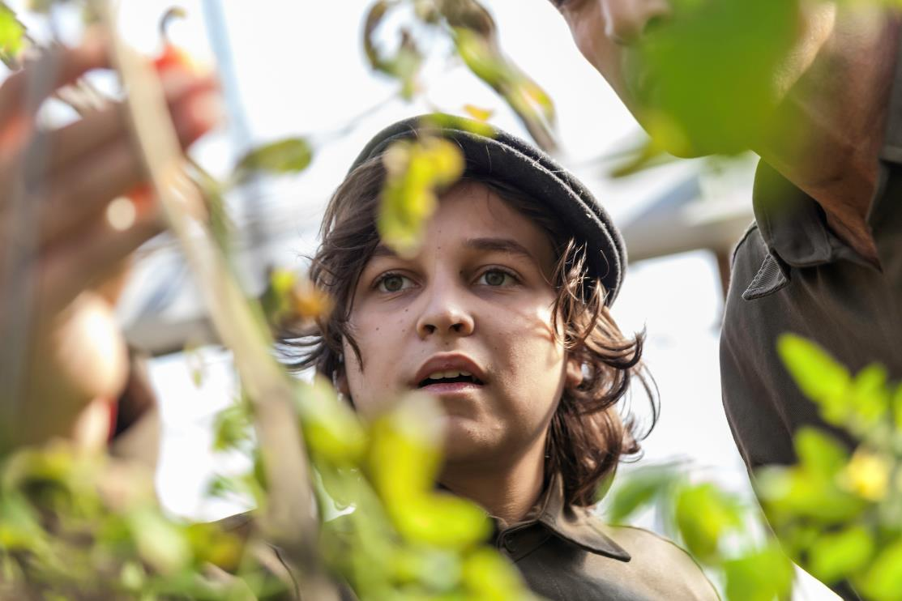
“
Having knowledge of our history allows us to understand where we are coming from, which in turn allows us to understand our present. It not only reveals the past, but it also helps us create a better future.
Heritage Value
”
In Module 4, we go deeper into the importance of Heritage Foods, and how you as smallholders can unlock their the heritage value. However, here we want to highlight to the opportunity you hold through your produce provenance as well and how this can mean premium.

Slide 15
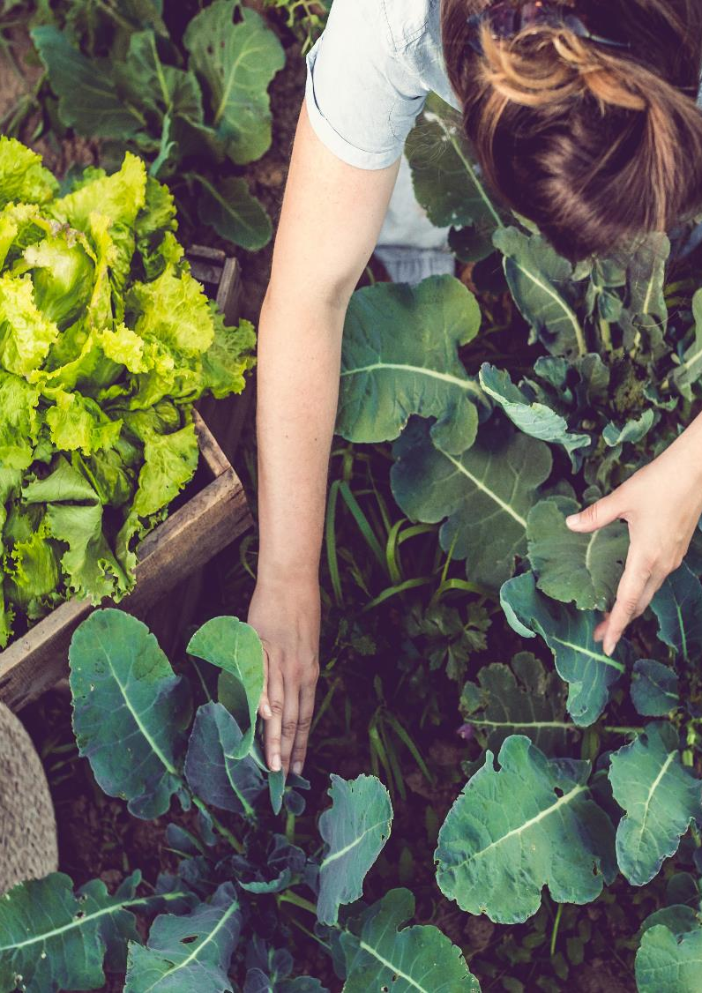
Provenance and Premium
Food provenance - the term used to describe the origin of food such as where it has been grown, raised or caught. Importantly, it provides the consumer with an understanding of how their food has been produced and transported. The different farming methods used to produce food affect the overall quality and taste. Increasingly, consumers are rightly demanding greater transparency and shorter food supply chains.
When we talk about local food provenance, we are talking about people, place and small scale. Consumers identify local with being able to link the product/brand back to a particular person and often location.

Slide 16
Provenance and Premium
UNESCO recognises a wealth of food and drink-related traditions, which are included in the Representative List of the Intangible Cultural Heritage of Humanity.
Premium - according to the Cambridge dictionary, Premium means “ an amount that is more than usual” i.e. your produce can be classed as premium produce due to its provenance!

Slide 17
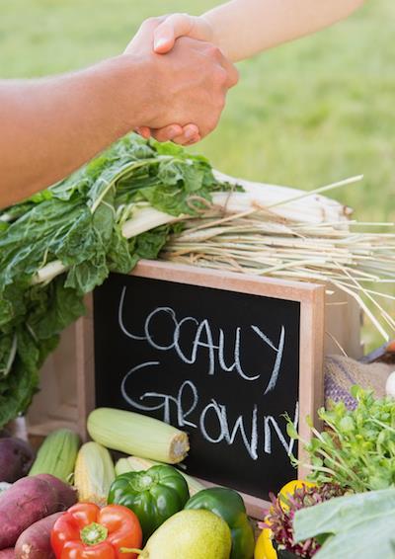
Artisan
“Artisan” is a term used to describe food produced by non-industrialised methods, often handed down through generations but now, is sometimes in danger of being lost. Tastes and processes are allowed to develop slowly and naturally, rather than curtailed for mass-production.
The Artisan Food movement is focused on providing farm to fork type foods with locally sourced products that benefit the consumer, small scale growers and producers, and the local economy. It is a popular and growing market in Europe driven by consumer tastes and trends.

Slide 18
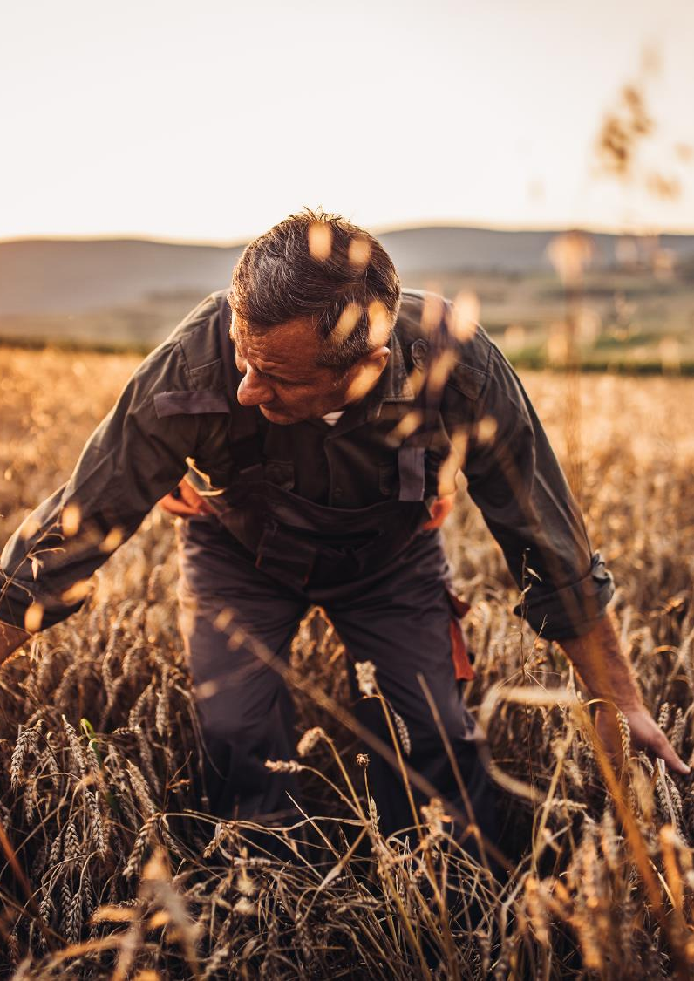
Believe in your value!
Premium value has been long associated with value-based claims or certificates like ‘organic’ or ‘sustainably farmed’. You need to believe that you are worth this perception of high value.
Shopping locally is a win-win in many respects. Consumers are enjoying higher quality produce whilst also helping the environment. Limiting the food miles reduces the carbon footprint the food leaves behind and supports the European food and farming sector and it is you, as smallholders, who are making this happen.

Slide 19
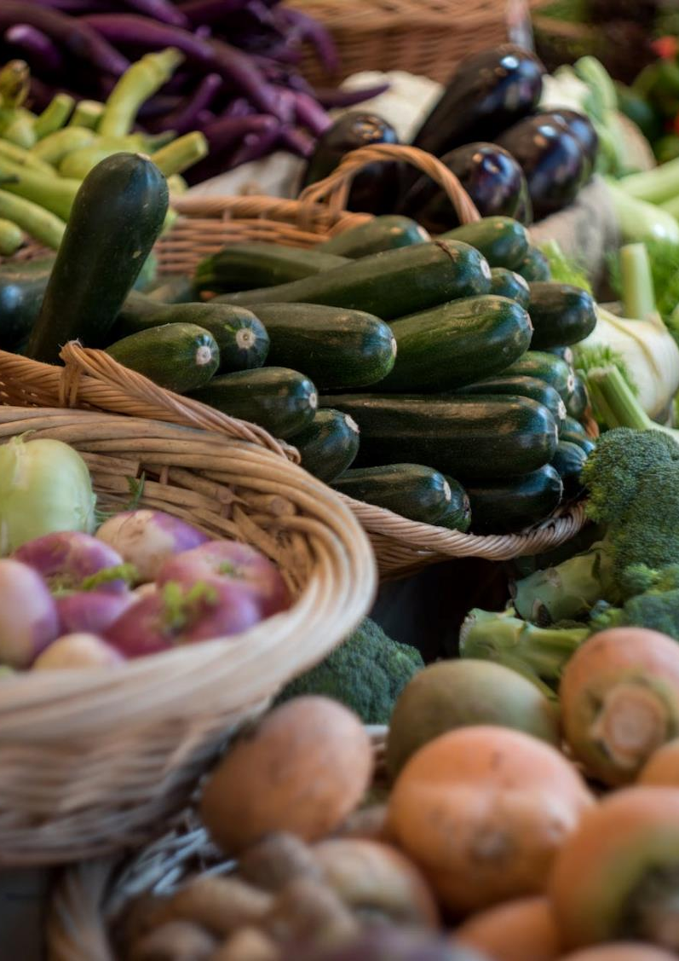
Selling your Heritage or Provenance…
In our post-Covid-19 world, the mantra of ‘buying local’ has resonated loudly. Many consumers have broken old shopping and eating habits in favour of trying out new ways to feed their families. As a result, farm shops and farmers’ markets are thriving, and we are even seeing the advent of pop-up weekly markets in villages and small towns.
To some extent, we are witnessing a return to our parents’ and grandparents’ shopping habits. We will share learning on ways of selling later in Module X.

Slide 20
03
Entrepreneurship Opportunities and Trialing your first product

Slide 21
Learning to be adaptive…
In Module 2, we will explore how important it is to to know your consumer and their need. Therein, you will also find opportunities as an entrepreneur. Needs can be seen as challenges, but challenges need solutions and that is where you as the entrepreneur come in!
There are opportunities all around us, but a certain mindset is often required to identify, verify and pursue that opportunity. Remember, the best leaders are known for being the best learners. Through this course, you will learn different approaches to entrepreneurial growth and the skills to maximise your success.
“Adaptability is the new competitive advantage.”
Harvard Business Review

Slide 22
Opportunities for Entrepreneurs to grow…
1
Adopt a Learning Mindset
No matter what industry or sector you are in, for entrepreneurs to become successful in business, just as the seasons bring change, you need to embrace change
We recommend you start with yourself and focus on these six entrepreneurial growth opportunities.
2
Learn Business Strategy
3
Enhance your Own Vision
4
Utilise Networks
5
Get Feedback and Pass on your Knowledge
6
Develop Self-Awareness

Slide 23
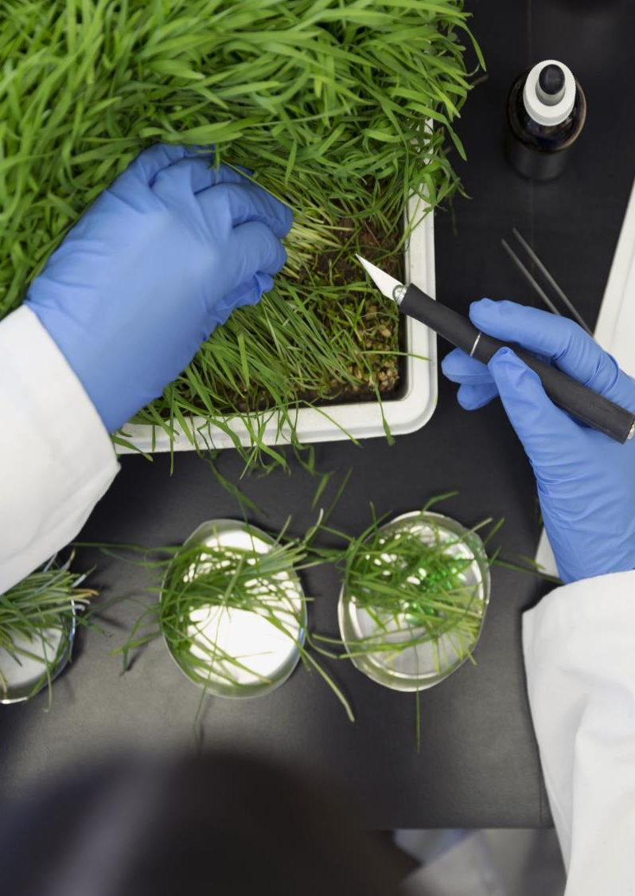
1. Adopt a Learning Mindset
The willingness to learn is one of the most crucial skills to acquire in life and entrepreneurship. Studies show that individuals achieve more with a growth mindset rather than having one that’s fixed. A desire to learn can be vital to business success.
Learning from mistakes or a failure is also a thing to consider as an opportunity. Nature teaching us this. These lessons are necessary and viable in expanding knowledge and understanding of how business works.
To improve your adaptability, set aside time to keep learning new skills regularly. Many skills can be a natural ability, but business and management skills are often developed through training & education.

Slide 24

2. Learn Business Strategy
In Module 2, we introduce you to tools and templates to help you build a business strategy to give structure and potential for the growth of your smallholding. Do not worry about the corporate language…
a strategy = a plan

Slide 25

3. Enhance your Own Vision
Some smallholders can get caught up in how others are achieving their successes. They look at how other smallholders do business and lose sight of their own vision. They often attempt to follow in their footsteps. However, you as a smallholder setting out/growing you business, you need to realise you can dissect your own plants, adapt, and move along your journey...remember to FOCUS and regularly reflect on why you started.
The key is to learn from everyone you meet and strive to be the best you can be, on your own terms.

Slide 26
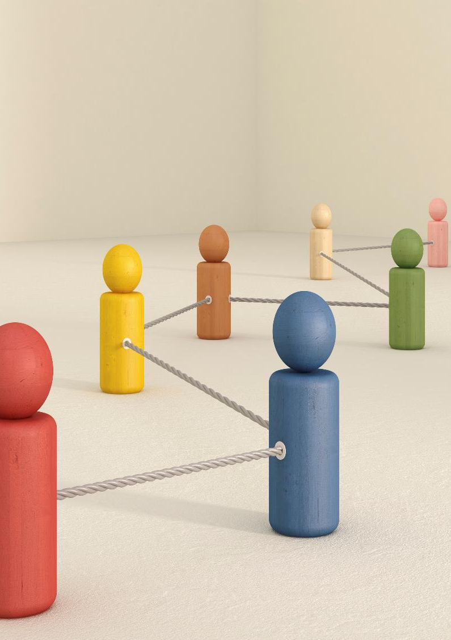
4. Utilise Networks
Focus on gaining practical advice from proven experts within your networks. This offers you the chance to take your ideas and turn them into an action plan.
A few methods for utilising your network can be in the form of friendly peer gatherings or professional groups:
    Farmer Co-ops and National Farmer associations
    Local food networks and marketing groups
You might find chatting with someone for a few hours can bring great clarity. Be sure to check out our Smallholder Supply Chain Collaboration Toolkit and be inspired by the power of collaborations.

Slide 27

5. Get feedback and Pass on your Knowledge
Some emerging entrepreneurs find it challenging to ask for feedback. Many only want to hear the positives in what their customers have to say (of course, many of us feel like this in some way).
However, to have real value, it needs to be a two-way street. Sharing what you already know about the business side of smallholdings, helps others and opens up new viewpoints and possibilities.
This type of engagement also leads you to broaden your perceptions of the often daunting world of business..

Slide 28
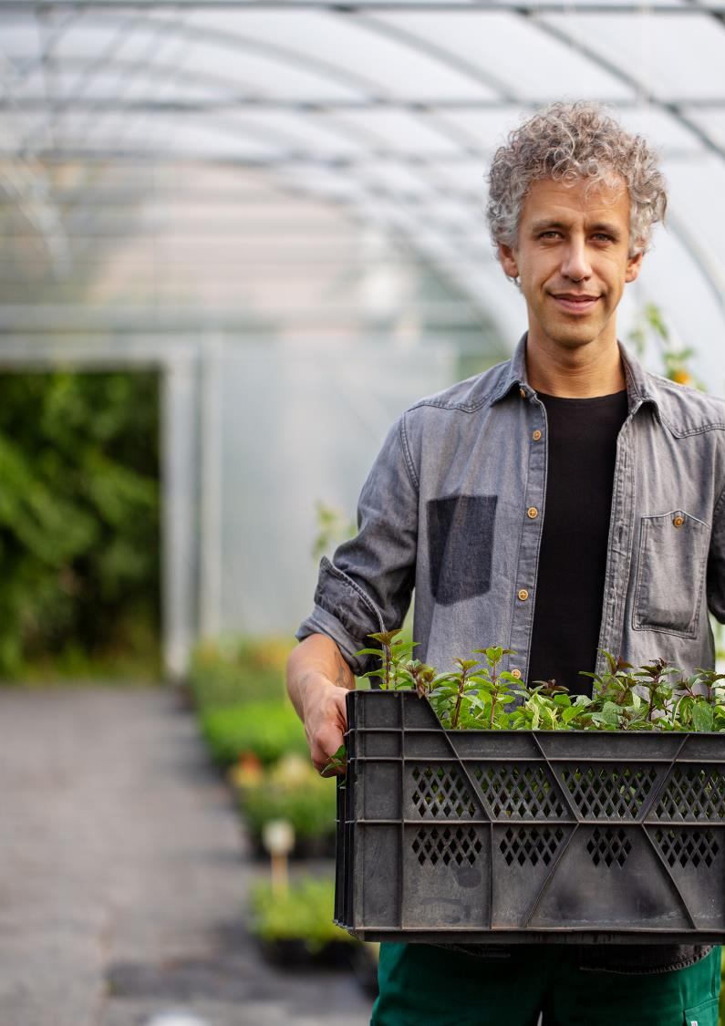
6. Develop Self-Awareness
Self-awareness is critical in operating any business venture. Given you will be balancing the many tasks of a smallholder, planning and tending crops/livestock, the finances and selling, you should observe your own actions during workdays and think about what improvements can be made.
When it comes to self-awareness, you should also find out what drives your motivation. You need to know where your strengths lie and leverage them and address your weaknesses so you can make improvements more quickly.
Later in this module, we discuss SWOT analysis which can make it far easier to identify potential pitfalls and opportunities.

Slide 29
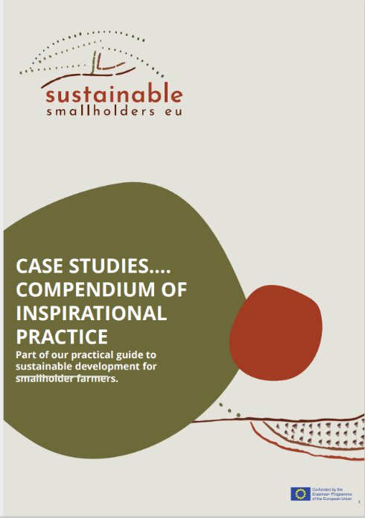
Be Inspired…how Challenges can become OPPORTUNITIES
A challenge or a problem can also be seen as an opportunity!!
In our Compendium of Case Studies, we examine 30+ Smallholders from across Europe and how they have adapted and thrived by utilising the resources that surround them, creating value for themselves and their customers.
CLICK TO ACCESS
…………

Slide 30
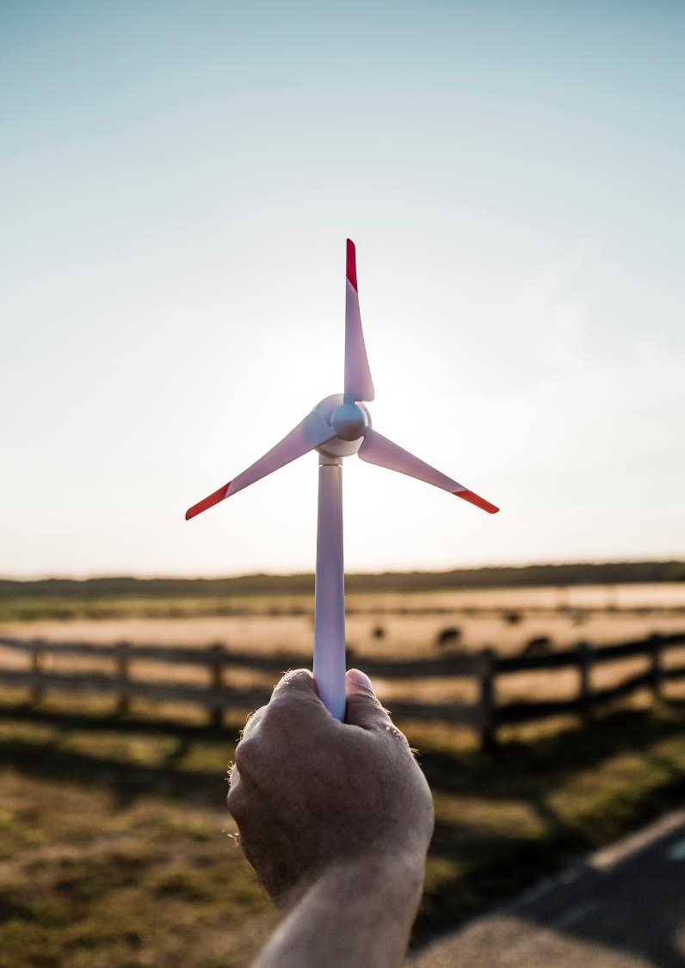
Have you heard about Frugal Innovation?
Frugal innovation is the ability to ‘do better with less resources for more people’, i.e. to create significantly more value while minimising the use of resources.’ Source
Frugal innovation is an attempt to maximise the ratio of value to resources. Value could be for your smallholding business, customers, or society more generally. Resources could be energy, capital or time.

Slide 31

WATCH: Frugal Innovation - three principles on how we can all do more with less
Navi Radjou has spent years studying "jugaad," known as frugal innovation. Pioneered by entrepreneurs in emerging markets who figured out how to get spectacular value from limited resources, the practice has now caught on globally. Let’s transfer it to smallholdings!
CLICK PLAY
SOURCE
Navi Radjou: Creative problem-solving in the face of extreme limits - YouTube

Slide 32
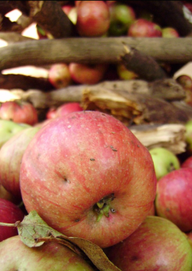
Be inspired! An example …
An example of frugal innovation, is promoting the use and recycling of “Ugly Food”. This is food that fails to enter the marketing chain because of non-conformity to packaging standards but is otherwise nutritious and safe. It is an obvious and simple way to reduce drastically unnecessary waste at wholesale and retail markets.
It does require raising awareness through education and communication campaigns from producers to consumers. Interesting such experiences already exist around the world.
An Interesting Read
The Hidden beauty of Ugly Food

Slide 33
Trialling Your First Product
Passionate and talented, smallholders are known to be exceptionally good at what they do – producing/breeding/growing artisanal produce rooted in the land and local communities with strong ethical, environmental, and heritage values. So you know you have a special product. We would recommend that you test the waters through trialling your product offering. Why ?
The purpose of a trial test in the marketplace is to provide a dress rehearsal for testing the product and marketing elements together. It tests your product and planned strategy in a real-world setting before significant investment is made. You get to test drive the product and marketing plan and make any changes to launch a product that will have the maximum chance of success in the marketplace.

Slide 34
Why Market Test?
The market test will give you a bank of information that encapsulates how consumers will react to your product, the price, its marketing, communications and promotion. It allows early decisions to be made that generate significant long terms cost savings. Trailing your a product allows you to gain customer feedback and insights on strengths and weaknesses prior to a full product launch. It is better to identify errors or concerns prior to distributing a product, rather than finding out about them after the fact.
Customers may also identify certain attributes or features of a product that they would like you to modify. Early adopters, those customers who like to be the first to buy a new product, may become loyal to your business when you allow them to participate in trials. Getting these customers on your side is especially beneficial in creating a domino effect through word-of-mouth advertising after a product launch. It helps build important loyalty.

Slide 35
Trialling – An Essential Ingredient in your Smallholding Business
Market research through trialling is the critical element of the process as it advises the direction of your entire trial and future direction. It informs on your target customer, how your product should be positioned, what your target audience need and value and how you can position your offering in a way that will resonate with potential customers.
Furthermore, it will identify your sales strategy – direct or distribution model? Where should you distribute your product and through which distribution channels? Would your target audience rather buy your product online, or direct?
Your research will also illustrate the importance of your pricing model. How should you price your product? What’s the average income of your target demographic? Will they find the product too expensive or perceive it too cheap based on the quality expected ? What kind of adjustments can you make in order to fit their perceived price point?

Slide 36
How to Trail your Product
Getting started with taking your products from your smallholding to the public can feel daunting, not least because of any ‘red tape’ that may apply to the sale of your produce. The following 9 key elements outline what a product trial will address:
Market research 2. Trial planning
Trial participant recruitment 4. Support requirements
5. Product branding and collateral 6. Marketing and promotional planning
7. Trial set up and implementation 8. Trial reporting
9 Product launch plan and budget

Slide 37
04
Business Plan Development

Slide 38
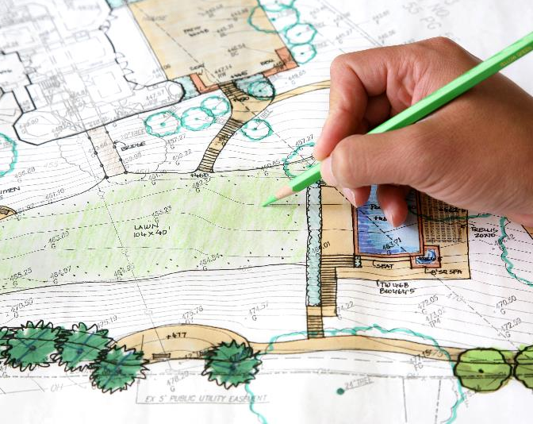
Exploring Ideas & Opportunities:
You are doing this course because you want to improve the business aspect of your smallholding. Creating a business plan is a step in the right direction on that journey, and it can open doors for funding etc.. Prior to writing your business plan, you must have ideas of opportunities to expand upon.
There are a few stages in this exploration:
Ideation: develop a concept for a new heritage/premium product that would work for you & the market you chose to sell into
Value these ideas: make the most of them and the associated opportunities
Mobilise the resources: gather and manage the resources you may need
Planning & management: Prioritise, organise and determine the best solutions to make it happen.

Slide 39
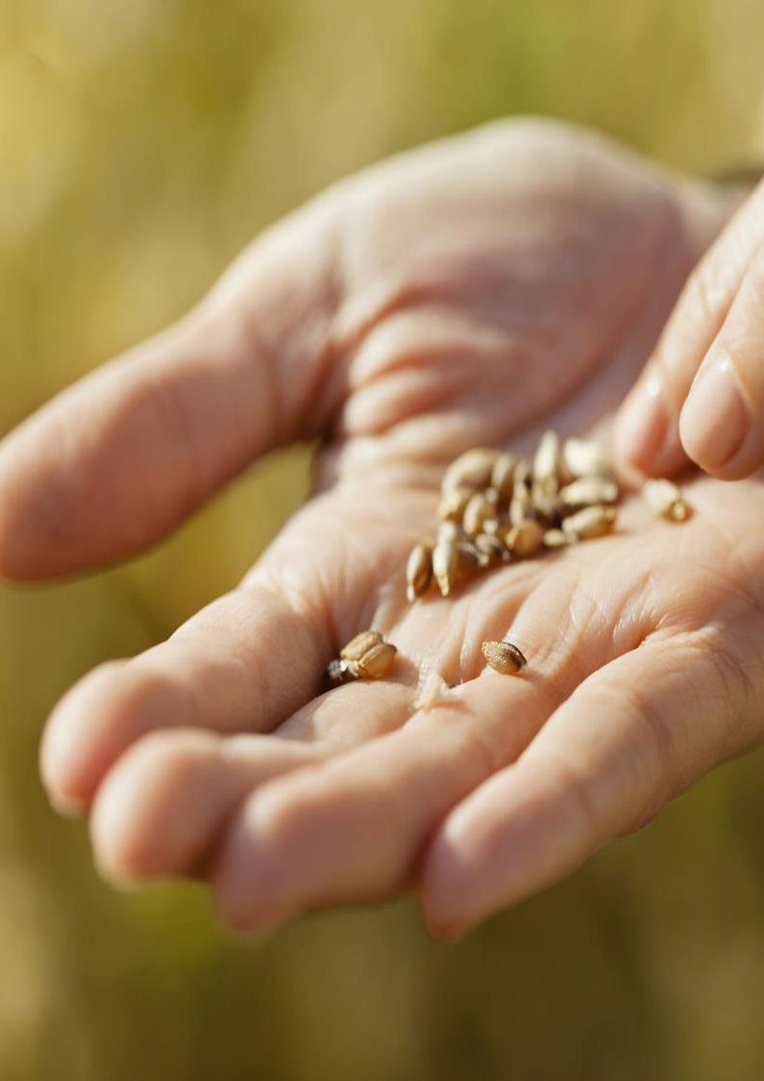
Creating your Business Plan…
with you for your future!
Developing a business plan involves thinking strategically about your business and making a plan to make your plan happen.
In this course, we help you to develop a simple and practical business plan that enables you to achieve your growth ambitions. Built around tools, templates, and resources that will help you, like the Design Thinking Process, the Business Model Canvas, and real-life case studies, we will help you to articulate your small enterprise objectives.

Slide 40

First things first, a Business Plan is…
a study done to understand the viability of a business, analysing the production operations, financial, market, and other points of view.
In short, it is a clear and organised way to project the necessary resources and expected returns for a business. This reduces risks and uncertainties

Slide 41
The outcomes…after completing this module you will have:
1
2
3
Produced and implemented a practical business plan to deliver business growth for your Smallholding.
Established processes to communicate the business plan to key stakeholders important to your smallholding enterprise’s success.
Developed the confidence and capability to further adapt the plan to address changing market needs as they arise.

Slide 42
Creating a Business Plan for your Smallholding
The Big Picture first ..
Yes, there is some business speak here, but let’s interpret!
Strategy
Your competitive game plan
Vision
What you want to be
Values
What you believe & practice
Mission
Why you exist

Slide 43
The Strategic Planning Process Steps…
1
2
3
4
5
Start with a Vision: what does the future of your smallholding look like. Reflect its uniqueness its distinctive features, and what your smallholding is able to achieve
Define Your Business Model: A business model describes the economic engine that drives your business
Prepare: to gain insight into your smallholding performance, market, and competitors
Execute an Effective Strategic Planning Process: should be well-thought through and well-planned
Focus on “the BIG Rocks” & create a one-page plan or canvas …continuously Review and revise the plan

Slide 44

Let’s Regroup…
There has been a lot of discussion this far on STRATEGY…please don’t let this word scare you off or intimidate you. Ultimately in this course we want to help you create and recognise the value of the work and produce you are already involved in, but we also want to show you that change and adaptations can be good for you, nature and for your customers. Therefore we encourage you to delve into this a little so that there is greater potential for doors opening and opportunities available to you as a micro-enterprise

Slide 45
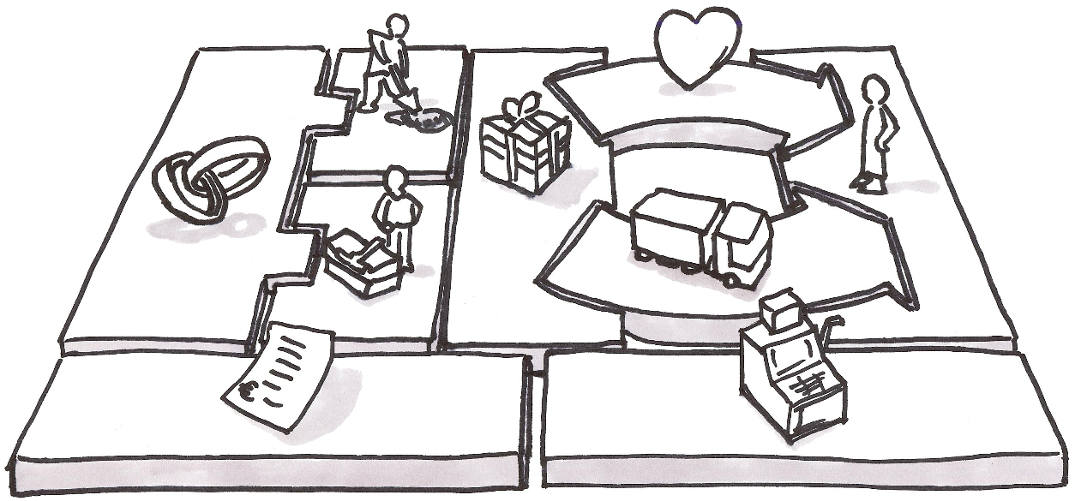
A Business Model is a tool that consists of a plan used to organise the various resources and key parts of a business

Slide 46

The Business Model…
A Business Model describes how your smallholding/enterprise CREATES, DELIVERS & CAPTURES VALUE in all contexts.
As an already established micro-business you should expect your Business Model to modify and adapt regularly to meet the needs and demands of customers and to react to events (e.g., Covid).
Your Business Model is in essence the vision of your business

Slide 47
How a Business Model Canvas can help you…
A business model canvas (BMC) is a business and marketing tool that serves as a guide for business owners to create business models. As it a simple format, it helps business owners see how all of the key business elements fit together.
The business model canvas template is structured to help business owners think about how they are going to fill their business with customers, money, and resources all at once. It can help you figure out what your target audience wants, how you plan on selling your products and/or services, and even forecast how much revenue you expect to generate each month.

Slide 48
How To Create a Canvas Model For Your Business
As we have explored, the business model canvas is key to business planning. It is an essential business tool that business owners need to use when they are creating business plans or nurturing business ideas. Business owners can create a business model canvas by answering the questions provided for each section of the canvas below.
KEY PARTNERS – This section should include a list of all other organisations and individuals that need to be involved in making the smallholder business a success. Take note
Who are your key partners?
Who else has an interest in the business success?
How do they contribute to its growth?
How can each organisation/person contribute ? Do they need to be compensated for their efforts? How much?

Slide 49
How To Create a Canvas Model For Your Business
2. KEY ACTIVITIES
The Key Activities section will include a list of all the tasks that need to be completed in order for your smallholder business model to work.
What activities are required to support your value proposition ? E.g. if you want to produce and sell organic products, in addition to your growing calendar and taks, it would include the process of becoming organic certified
What activities are required to support the relationships with your consumers?
What activities are required to support your revenue sources?

Slide 50
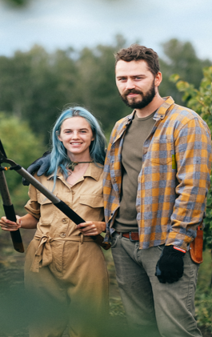
How To Create a Canvas Model For Your Business
3. KEY RESOURCES
The Key Resources section should focus on what types of equipment, labour, and funds are needed in order to make this business successful.
• What equipment is needed to start this smallholding business?
• What type of labour does this smallholding business require? Your own? With others?
• How much funding will I need in order to start this smallholding business?

Slide 51
How To Create a Canvas Model For Your Business
4. VALUE PROPOSITION
The Value Proposition section details what your customer base will receive in return for their money and time.
• What makes your product or offering unique?
• What value does it bring compared with other similar smallholder businesses?
• What are the different benefits that your smallholding business offers to its customers?
• How will you be able to differentiate yourself from other brands or products on the market?

Slide 52
How To Create a Canvas Model For Your Business
5. CUSTOMER RELATIONSHIPS
The Customer Relationships section should include all of the ways that you plan on communicating with your consumers, including social media to help promote your offering
• How will you communicate with consumers throughout the buyer’s journey?
• What is the best way to market your smallholder business?
• Which social media platforms do you use?

Slide 53
How To Create a Canvas Model For Your Business
6. DISTRIBUTION CHANNELS
The Distribution Channels section is all about how the product will be sold.
What are the best sales channels to reach your target audience?
How are these channels integrated?
Which channels perform the best?
Which channels are the most cost-effective?

Slide 54
How To Create a Canvas Model For Your Business
7. POTENTIAL CUSTOMERS
This section includes a list of all potential customers within your target group.
How do I identify my customer segments?
What are their demographics?
Which geographical areas will this smallholder product be offered in?
Why would these particular groups purchase from me over others that sell similar products to mine?

Slide 55
How To Create a Canvas Model For Your Business
COST STRUCTIURE
The Cost Structure section is a list of everything that you will need to invest in order to run your smallholder business successfully.
What are the different costs associated with starting and running this business?
How much money do I need upfront?
Which resources am I able to provide myself without having any additional expenses?
For example, if you are creating a business that will sell online, it’s important to include things like hosting costs or website design fees. If your startup requires physical products, then you’ll need to factor in materials and labour costs into this section of the canvas.

Slide 56
How To Create a Canvas Model For Your Business
9 REVENUE STREAMS
The Revenue Streams section is a list of all the ways that you plan on making money from your smallholder business.
• What are my different streams of revenue?
• How much money can I make from each one?
• Which resources am I able to provide without having any additional costs or expenses attached to them,?
For example, if you’re selling a product then your revenue stream would be the price of each unit sold, then it’s important to list all potential clients here so that you are clear exactly will be paying for this and how much money they will potentially provide.

Slide 57
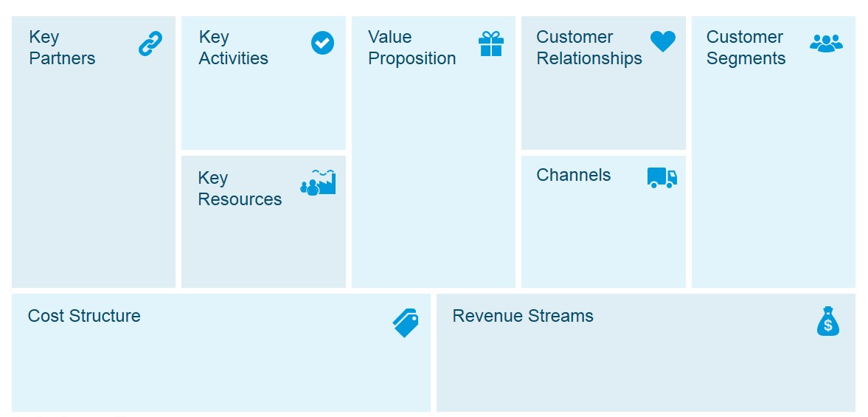
EXERCISE: Create a Canvas Model For Your Business
Use our editable template to bring all sections together. Remember it needs to be concise and very clear.

Slide 58
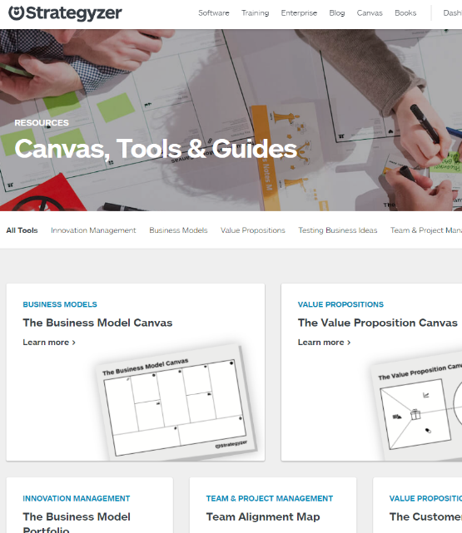
Here are some useful and easy-to-use resources to help you on this journey…
Strategyzer is a complete platform of several methods, tools and templates to capture your business model approach.
Access free content through this link
https://www.strategyzer.com/resources/canvas-tools-guides

Slide 59

Strategyzer’s Business Model Canvas… Their Definition:
A business model describes the rationale of how a business creates, delivers & captures value
It can be described via 9 building blocks:
Customer Segments
Value Propositions
Channels
Customer Relationships
Revenue Streams
Key Resources
Key Activities
Key Partnerships
Cost Structure
Business Model Canvas Explained - YouTube

Slide 60
What you have learned so far…
An effective business model helps you to figure out elements such as:
Your business concept
What problem are you solving and for whom?
How will your smallholder product get to customers?
How will your business stay competitive?
All revenue and costs you can anticipate.

Slide 61
04
Strengths, Weaknesses, Opportunities and Threats

Slide 62

We recognise the opportunity & can identify our customer what next?
W
You now know a Business Model is a plan for the successful operation of your small smallholding business, by identifying sources of revenue, the intended customer base, products, and details of financing.
A key component of our business model includes your business strengths and challenge. We can obtain these by carrying out a SWOT analysis
S
O
T

Slide 63
SWOT Analysis
Internal
STRENGTHS
What you do well
Qualities that separate you from competitors
Skilled/ knowledgeable staff
Your USP (unique selling proposition)
WEAKNESSES
Things your business lacks
What your competitor does better
Resource limitations
A SWOT analysis is a simple, but powerful, framework for leveraging any business or project’s Strengths, improving Weaknesses, minimizing Threats, and taking the greatest possible advantage of Opportunities.
SWOT analysis is a process where you can identify the internal and external factors that will affect your Smallholdings or project’s future performance.
OPPORTUNITIES
Under-served markets
Few competitors in area
Emerging need you can fill
Project participation
THREATS
Emerging competitors
Changing regulations
Changing customer attitude to your business
External

Slide 64
Strengths:
This refers to internal areas of your smallholding. Examining these areas helps you understand what’s going to work. You can then use the techniques that you know work—your strengths—in other areas that might need additional support, like improving your growing processes etc.
When looking into the strengths of your smallholding, ask yourself the following questions:
What do we do well? Or, even better: What do we do best?
What’s unique about our farm or produce?
What does our target customer like about us?
Which features beat out our competitors?

Slide 65
Weaknesses:
This refers to internal areas that are underperforming. It’s a good idea to analyse your strengths before your weaknesses in order to create the baseline of success and failure. Identifying internal weaknesses provides a starting point for improving those areas.
Identify the farm’s weaknesses by asking:
Which initiatives are underperforming and why?
What can be improved?
What resources could improve our performance?
How do we rank against our competitors?

Slide 66
Opportunities:
Opportunities in SWOT result from your existing strengths and weaknesses, along with any external opportunities that will put you in a better competitive position. These could be anything from the mareketthat you’d like to improve or areas that weren’t identified in the first two phases of your analysis.
Since there are many ways to create opportunities, it’s helpful to ask these questions before starting:
What opportunities arise in my local marketplace?
Are there market gaps in our services?
What are our business goals for the year?
What do our competitors offer?

Slide 67
Threats:
Threats in SWOT are areas with the potential to cause problems. Different from weaknesses, threats are external and ‌out of your control. This can include anything from a global pandemic to a change in the competitive landscape.
Here are a few questions to ask yourself to identify external threats:
What changes in the agrifood sector are cause for concern?
What new market trends are on the horizon?
Where are our competitors outperforming us?

Slide 68
Now you can delve further into…
Your business concept – Promoting your smallholding in a sustainable manner and restoring culinary and cultural heritage through protecting species and traditional farming techniques.
What problem are you solving and for whom? – Fulling a need for low mileage foodstuff in the region. Preventing the loss of our cultural heritage. (For the local community) Increasing and adding value to primary produce income. (For you and your family)
How will you create customer value? – Keeping various species, breeds and varieties alive and telling the story of our heritage through a diverse produce offering.
How will your product or service get to customers? Direct sales or through local co-ops and by developing partnerships within the sector.
How will your business stay competitive? By constantly innovating and diversifying your product offering and the way you service the market
All revenue and costs you can anticipate. How cane you increase revenue by re-positioning your produce for a premium market.

Slide 69

Bringing together your BUSINESS PLAN…
As mentioned earlier a business plan is a written document that describes your business, in terms of objectives, strategies, sales, marketing and financials.
      A business plan helps you to:
      clarify your business idea
      spot potential problems
      set out your goals
      measure your progress
You’ll need a business plan if you want to secure investment or a bank loan. It can also help to convince suppliers and potential stakeholders to support you.

Slide 70

Writing your BUSINESS PLAN…
The following documents are blank business plan templates and aids that you can download, edit, print, and fill in to help you start your journey of growth or development…
Business Plan Template from Enterprise Ireland
Business Plan Template with useful hints
Teagasc Step by Step Guide to doing the figures
It is now time to make your first attempt at writing your Business Plan and bringing all your work thus far together in one document!
At this stage don’t worry too much about the financials…we will cover this in more detail in Module 2

Slide 71
Well done!!!
You have just completed Module 1. It wasn’t easy and we covered many topics that you may not have been familiar with. Starting is always the hardest step.
Keep going now and jump into module 2 where we discuss Assessing and Improving your Financial Literacy
www.small-holders.eu

