Slide 1
Module 5:
Focusing on Sales for Smallholders

Slide 2
Module 5 Focusing on Sales for Smallholders
This module places emphasis on the importance of your value proposition as the foundation for sales and creating good sales techniques in order to develop your smallholding as a viable enterprise.
We explore the various sale channels so that you are more informed when choosing the right channel for you and we discuss how to manage sales contracts with potential customers and how to negotiate the right contract for you.
1
Creating your Value Proposition
2
Choosing the right Sales Channel for you
(B2B, B2C, Collaborative Sales/Sales Networks)
3
Managing Sales Contracts
4
Developing Negotiation Skills

Slide 3

Link your Learning to the Supply Chain Collaboration Toolkit
As a smallholder, you are a vital part of a much bigger and broader industry You already work with a number of customers, suppliers and peers In our other resource, Supply Chain Collaboration Toolkit, you will learn of the benefits of developing formalised relationships with potentially key partners in ‘growing’ the success and profitability of your small holding.
We will look at areas where collaboration may benefit your smallholding and how best to explore how to implement that. Avoiding time consuming or unsuccessful supply relationships and understanding how to effectively manage future collaboration will all be considered. Hopefully, offering some thought provoking yet achievable ideas to consider.
BUT FIRST, SOME SALES SKILLS……

Slide 4
01
Creating your Value Proposition

Slide 5

What is a Value Proposition?
Before you actually start to sell, it is important to put in place you Value Proposition (VP) so you can bring the value of heritage produce into play. What is a VP? Marketeer Peter Sandeen tells us a VP is:
“A believable collection of the most persuasive reasons people should notice you and take the action you’re asking for.”
A value proposition answers the basic question: WHY they should choose you?
It's not just some internal statement that you file away in your business plan. This is your unique advantage in the marketplace and should be the first thing people see before they buy from you.
FREE WORKSHEET
https://www.allagmedia.com/s/aam-value-proposition-worksheet.pdf

Slide 6

Where do you start?
Always start from the perspective of your customer. You probably started your farm business because it was something you had a passion for. The things that get you excited aren’t necessarily the things that get your customers excited, though.
As we learnt in Module 2, the first thing you need to do is identify your ideal customer. And keep in mind that your customer might not be the end user. You might be selling organic produce and your customer is a restaurant chef, but the end user is a diner in that restaurant. It’s important to understand this frame of reference.

Slide 7
STEP 1: IDENTIFY YOUR OPPORTUNITY / IDENTIFY THE CUSTOMER’S PROBLEM
Former Harvard marketing professor Theodore Levitt said:
“People don’t want to buy a quarter-inch drill. They want a quarter-inch hole.”
Closing sales is about winning customers. You do that when they’ve decided you are the best one to fill their need.
Value propositions are one of the most important conversion factors. A great value proposition could be the difference between losing a sale — and closing it.
Let’s say you have a vineyard/winery and 66% or more of sales come from on-site purchases. This tells you people aren’t buying convenience or even wine, they’re buying an experience in visiting your premises and making their choice. The value this business delivers is experiential (See Module 4), you are providing a place for friends to connect while relaxing and enjoying a glass of wine. This is the opportunity and the solution to the customers ‘problem’!

Slide 8
STEP 2: MAKE A LIST OF THE BENEFITS YOU OFFER
There is a difference between features and benefits. Features are specific attributes of your business. Benefits are WHY they matter.
The benefits are the value you provide or the way you solve your customer's problem. They connect on an emotional level…Remember: sell the hole, not the drill.
Let's consider some more practical examples of features versus benefits:
1. Box scheme
Feature: 26-week subscription to a box scheme
Benefit: Enjoy fresh, seasonal produce
3. Agriculture Tourism
Feature: Curriculum-based farm field trips
Benefit: Engaging learning experience tied to classroom objectives
2. Rustic Wedding Venue
Feature: 20-acre Rural Farm
Benefit: Private setting for your wedding

Slide 9
STEP 3: DIFFERENTIATE
We live in a world where people are pressed for time. They want answers. They want things simple. Don’t expect them to understand how you’re different unless you tell them.
There’s a reason you stand out.
Some common differentiating factors are:
Best quality - you offer something better than your competitors
Best value - this doesn't always mean least expensive, but rather offering a better value in the big picture
Scarcity - you offer something that's unique or hard to find
Luxury - you offer something that people don't need but they want to satisfy themselves
Necessity - you offer something people need and can't do without

Slide 10
STEP 4: WRITING THE VALUE PROPOSITION
After you’ve gone through steps 1-3, you should write a short statement that brings it all together.
A common template is: We help X do Y by Z.
Another approach is: verb, application, and differentiator.
Or you can turn your value proposition into a question.
Example: An agritourism operation…We help families make memories at Old McDonald’s farm.
Example: A sweet corn grower… Taste summer in every bite.
Example: A lamb producer… Want to impress your dinner guests with flavoursome mountain lamb?
A value proposition will help you do more of what you love to do by telling your ideal customer why your business is the best choice.

Slide 11
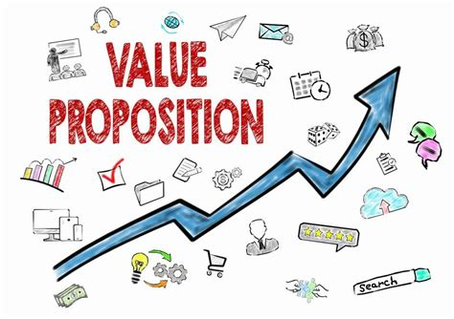
What makes a good Value Proposition?
Clear Language
Specific Language
Specific Outcomes
Points of Differentiation
Writing your Value Proposition…
Using the structure/template below can help you to write your VP…
Our [product/service]
Help(s) [customer segment] = WHO
Who want to [customer job] = WHAT
By (verb) [customer pain] = HOW
and (verb) [customer gain] = HOW
Unlike [competitors] =WHY
WHO: Who you serve.
WHAT (Problem): What problem you solve for them.
HOW (Result): How you create that result for them.
WHY: Why they should choose you

Slide 12

Your value proposition IS a unique identifier for your business.
Your Value Proposition is NOT…
For Example…
A slogan
A mission statement
A positioning statement
An elevator pitch
A catch-phrase
Hype
A slogan is a short, catchy statement that brands use in marketing campaigns to sell a specific product.
Your value proposition details what you offer customers and why they should choose you

Slide 13
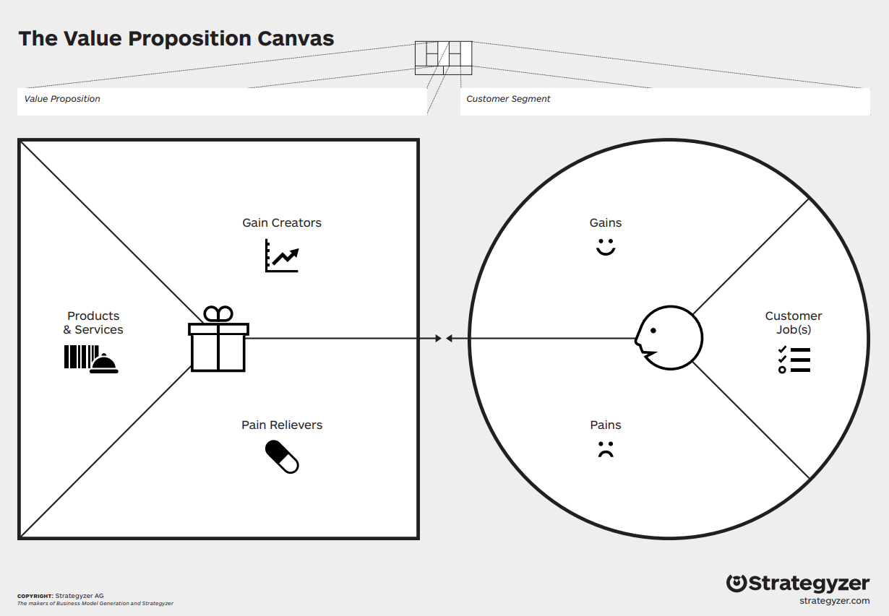
The Value Proposition Canvas:
The Value Proposition Canvas is a plug-in tool to the Business Model Canvas that we discussed in Module 1. It allows you to describe your Value Propositions and the target Customer Segments in more detail and evaluate the “fit” between the value you intend to create and the expectations your customers have.
ACTION: Download and use a pdf version here: https://www.strategyzer.com/canvas/value-proposition-canvas

Slide 14
The Value Proposition Canvas:
You can use this map before, during and after developing an in-depth knowledge of your customers. If you use it before, it will highlight what you need to learn about customers and test value propositions. If you use it after, it will help you analyse and evaluate the “fit”.
The Value Proposition Canvas can be applied to new and existing value propositions and customer segments alike. In both cases, it will help you structure your thinking and make your ideas more tangible

Slide 15
Instructions on how to use the Value Proposition Canvas
Describe your products & services:
Outline how you intend to create value:
Start with customer:
Add Pains and Gains:
Start sketching out your map by describing what the need of a specific customer is.
Add a post-it for every pain your customer has or could experience before, during & after getting buying your product. Add a post-it in the Gains box for every benefit your customer expects, desires or would be surprised by.
List all the products & services your value proposition is built around by creating a post-it for each element in the Products & Services box.
Describe how your products and services create value by either killing customer pains or creating customer gains. Create a sticky note for each element in the Pain Relievers or Gain Creators box respectively.

Slide 16


Best Practices when using the Value Proposition Canvas
Colour coding: Using different colours for the different elements can help you “read” the map more quickly. You can use yellow post-its in the Customer and Products & Services boxes, e.g., pink post-its in the Pains box, and green post-its in the remaining boxes, since they are all related to value creation.
Customer Knowledge: If you need to, bring in external contributors who are in frequent contact with the customers you are targeting and thus have deep customer knowledge, (e.g. chefs/ restaurant owners)

Slide 17
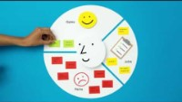
WATCH: The Value Proposition Canvas
This short video demonstrates how to use the Strategyzer Value Proposition Canvas. This can be a very useful TOOL in helping you identify your customers and by focusing on what their pains and ideal gains are.
The more you know about your customer the better that you will be able to create your Value Proposition and create a link between the two.

Slide 18
Quick Summary…Why use the Value Proposition Canvas?
Precisely define your customer profiles
Visualise the value you create
Achieve Product-Market fit
Identify your customer needs, the pains they face and the gains they perceive by buying your produce.
Define the most important components of your offering…how you relieve pain and create gains for your customers.
Adjust your Value Proposition based on the insights you gained from customer evidence and achieve Product-Market fit.

Slide 19
02
Choosing the correct Sales Channel for you

Slide 20

Sales is the process of convincing someone to buy from your business. Strong sales techniques are vital to driving business revenue and growth.
Quite often sales involves some level of interpersonal interaction that persuades a potential customer to become an actual customer. Most of the time, your potential customers come to you or find you as a result of your marketing efforts.
In this section of our Module, we look at the different routes that are open to you.

Slide 21
Sales via Business to Consumer
Retail and Distribution
Selling your goods through a retail distribution channel is one option for reaching customers efficiently. If you have a small number of customers, you can deal with them directly, but if you are expanding your operations, you may find it difficult to reach a larger, more widespread customer base.
This is where a distributor comes in. A distributor acts as the middleman between consumers and manufacturers.

Slide 22
Sales via Business to Consumer
Subscription Services
COVID19 has led to the rebirth of the subscription boxes, people are loving them and sales for them are booming!
Why do people love them? Once a consumer gets a taste of the convenience and joy of receiving monthly packages, they get hooked. But why? A 2018 study by McKinsey & Company broke down the subscription box companies into three categories: replenishment, curation, and access.
Simple put – subscription boxes offer something new and exciting in a convenient way each month!

Slide 23
Sales via Business to Consumer
Online Sales/Home Delivery
As we will learn in Module 6, the impact of digitisation on the food world cannot be underestimated. By 2023 it is expected that the online groceries market will see a 66 % turnover growth in Europe, reaching 47 billion euros.
For the customer, the convenience of shopping for food online is alluring. While retailers have been slow to embrace ecommerce, many small food entrepreneurs and food companies are leading the way and have even based their whole business model around online sales and home delivery.

Slide 24
Sales via Business to Consumer
Farmers Markets
Farmers’ markets are often a vital, low-cost route to market in the start-up phase and beyond. They also became a new route of market for many food producers and entrepreneurs who have had to close their regular businesses (cafes/restaurants) due to Covid19 restrictions.
Food or Farmers Markets are a great opportunity for local food producers and entrepreneurs to tell their story and to understand what captures consumers’ interest – what consumers regard as authentic and unique and what would encourage them to purchase on a regular basis.

Slide 25
Sales via Business to Consumer
Street Food
Street food is one of the most vibrant and fast growing sectors in European economies, building on consumer interest in high quality, artisan food and the rising number of farmers’ markets, outdoor festivals and public events.
‘Street food’ is artisan food sold on the streets, or more accurately, not served from restaurants or cafés.
The street food revolution is in full swing and has grown massively over the last 10 years.
Despite this growth, new types of foods and modern twists on old classics are still emerging. This means there is still room for new ideals for people wanting to start out in this industry.

Slide 26
Sales via Business to Consumer
Catering Services
Catering refers to a service that delivers food to a client's location, and may also cook and serve it on site. Options range from full-service caterers that cook, deliver, set up and serve at an event to mobile or industrial caterers.
Catering services can also be offered to corporates & organizations, whereby you prepare and serve the food daily to company employees, or at corporate seminars & training events, business conference catering etc.
Social event catering also has a big market, you can offer your catering services at music events & concerts, social parties like birthdays etc.

Slide 27
Sales via Collaborative Sales/Networks
A food cooperative or food co-op is a food distribution outlet organized as a cooperative, rather than a private or public company.
This cooperative provides a sales outlet for the products supplied to it by members and patrons. A typical example of a cooperative is that of a farm cooperative.
In this example, a farm sells livestock and crops on an ongoing basis through a cooperative who looks after the marketing and sales of products to third parties.

Slide 28
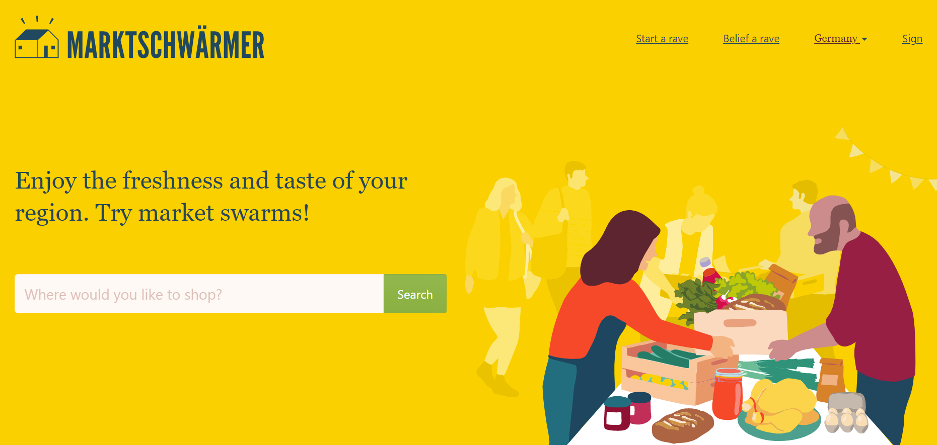
Market Swarmer (Germany) creates regional networks of producers and consumers. Their objectives are direct access to regional food for all and fair pay for the people who make it. Market swarmers are part of the social movement for sustainable agriculture and fairer economic action.
www.marktschwaermer.de

Slide 29
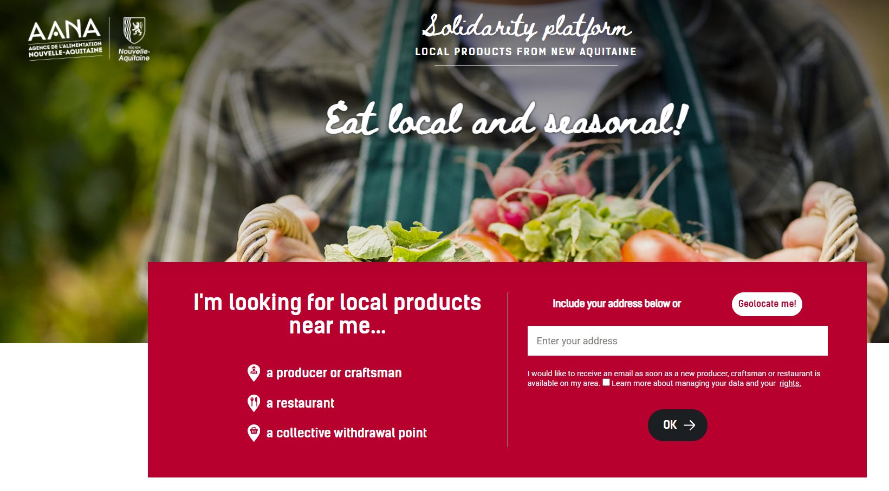
The Nouvelle-Aquitaine Region and the Nouvelle-Aquitaine Food Agency (AANA), in partnership with the Chambers of Agriculture and the Chambers of Trades and Crafts have launched a digital “Solidarity” platform to connect producers and consumers in this region of France.
www.plateforme.produits-locaux-nouvelle-aquitaine.fr/

Slide 30
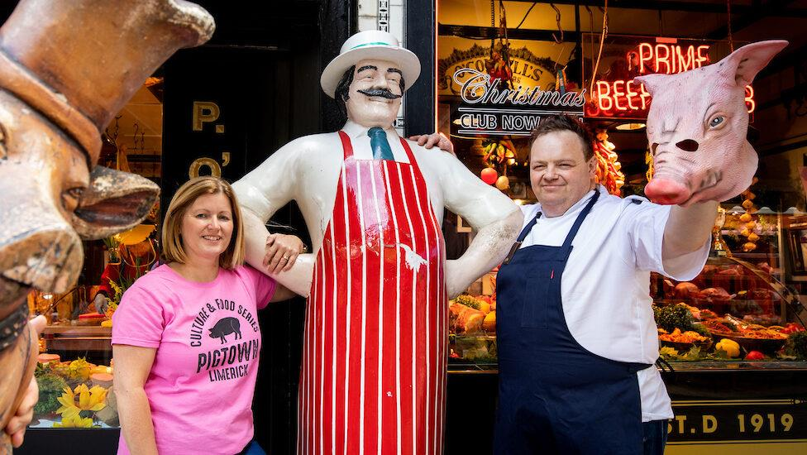
Inspired by the cities’ famous bacon industry, the Limerick ‘Pigtown Culture and Food Series’ (Ireland) was developed by Limerick Food Group and supported by Limerick City & County Council. The series focuses on Limerick’s unique heritage as a way to showcase the great food available locally, rooted in food heritage – www.pigtown.ie

Slide 31
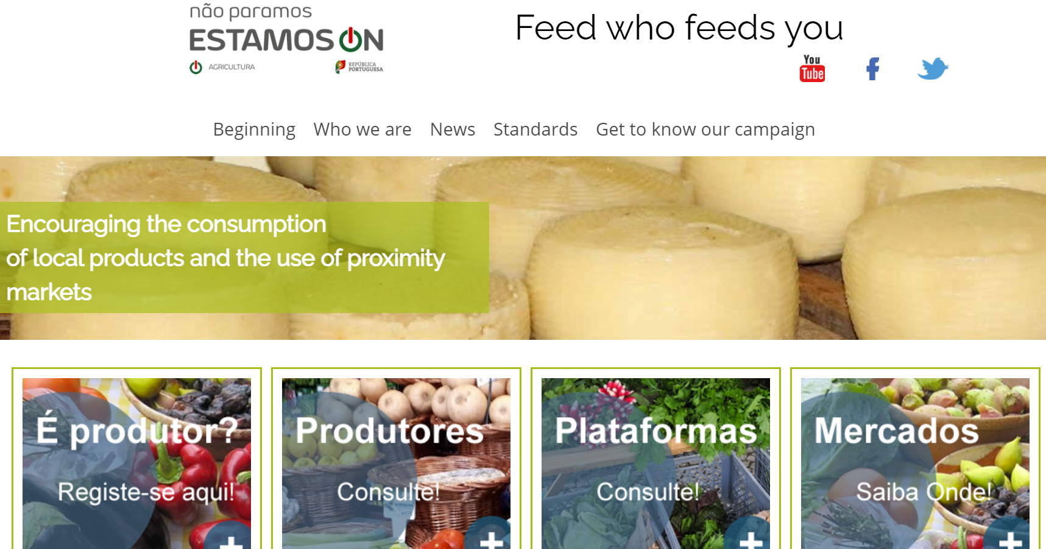
The Ministry of Agriculture (Portugal) 'Alimente quem o Alimenta' (“Feed who feeds you”) platform brings producers and consumers closer together by supporting the consumption of national products and short food supply chains. www.alimentequemoalimenta.pt

Slide 32
03
Managing Sales Contracts with Retailers

Slide 33
Product
In order to sell to a retailer, you need the following :
Shelf-ready packaging appropriate to whatever product you are selling
Proper labelling and barcodes must be in place
Product must have “ use by” or “best before Date”
Only promise the volume of product you can deliver

Slide 34
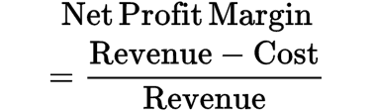
Price
You have to decide the margin your need to ensure that the business is profitable
Many retailers will take up to 60% between the distributor and their own margin
The producer will generally need a 30 to 40% margin, but this depends on the product type.
Formula

Slide 35
Distribution
Distribution often is the most difficult aspect of dealing with retailers. Some supermarket campaigns give small producers a chance to get started with a retailer with small volumes of product. Most small producers start dealing directly with shops delivering directly
  Advantages: The producer gets a larger margin and can control the shelf space
    Also, the producer can take time to scale up for larger orders
  Disadvantages: Higher costs having to deliver to all shops (Vans and drivers)
    Retail mostly moving to central distribution (back door delivery unwanted)

Slide 36
Negotiating with the Buyers
Buyers are there to get the best deal for the retailer
They can be demanding, and it is important that you know what margin you need to come away with when meeting them.
Know the Unique Selling Points (USP’s) of your product and be able to differentiate them from others that they already stock.
Be aware of all your competitors and their prices and USP’s
Never be critical or knock competitors’ products, but just focus on the merits of your own product (in the next section we explore negotiation skills further)

Slide 37
Finalising a supply contract
The deal may involve multiple buyers and others in the buying team
Find out who the ultimate decision maker is and make sure that they have all the prices quotes and samples required to make the decision
Ensure that if you have a chilled product that you have a chilled courier to deliver the product, as they cab be difficult to source for a a small company.
Continuity of supply is crucial to maintaining the supply contract. Retailers are very unforgiving if they have bare shelf space.

Slide 38
04
Developing Negotiating Skills to Boost Sales

Slide 39

What is Negotiation?
Negotiation is a dialogue between two or more parties with the intention of reaching a mutually beneficial outcome or resolving a conflict. In negotiation, each party will try to persuade the other one to agree with his or her point of view. The goal is to avoid arguments and disputes and reach some form of compromise between parties.
Negotiation is such an important skill in the sales process. Some examples in normal, everyday life include negotiating a price at a market, dialogue with your child to get them to agree to eat their dinner or agreeing on suitable compensation for a long term produce supply.
Kids are SUPER HEROES at negotiating…watch a learn from them ☺

Slide 40
Negotiation Skills​
What skills does a good negotiator need?
​
Strong negotiators will develop their written, verbal, and non-verbal communication skills. Good negotiators usually exhibit the following traits:
Effective speaking​
Effective/active listening​
A sense of humour​
A positive attitude ​
Respect
Flexibility
Honesty
Self-confidence
Emotional intelligence
Persistance
Patience
An ability to influence

Slide 41
Two Types of Negotiation…
Characteristics | Distributive | Integrative
Goal | Get all the pie you can | Expand the pie
Motivation | Win-Lose | Win-Win
Focus | Positions | Interests
Information Sharing | Low | High
Relationship Duration | Short-Term | Long-Term

Slide 42
Having Self-awareness and Awareness of Others from the outset…
Before starting a negotiation, it is important to assess not only what you are seeking out of the negotiation, but you must keep in mind what the other party is seeking as well. Only by understanding each other’s desires can you hope to fulfill both parties’ needs in a win-win scenario or INTEGRATIVE
If you only seek a scenario where only you get what you want, but the other party is disadvantaged, you will create hostility and are less likely to end up getting the outcome you desire. This is more like the DISTRIBUTIVE type.

Slide 43
If negotiations are required…BE PREPARED!
1
Think about your perceptions of the other person or party
Preparation is key when negotiating to ensure your best outcome.
How do you prepare for a negotiation?
2
Clarify your aims with yourself
3
Gather information – do your homework
4
Negotiate internally with your own side first - practice
5
Prepare the setting
6
Prepare yourself mentally and decide who goes first.

Slide 44
Common Negotiation Mistakes
Being under-prepared
Assuming that everything is ok
Giving in too quickly
Let emotions get the better of you
Overconfidence
Being too fixed in your approach
Not asking targeted questions (5Ws’: Who? What? Where? When? and Why?)
Relying on past performance ‘it worked last time’

Slide 45
The main four Phases in the negotiation process…
1. Discussion Phase
2. Clarification Phase
3. Negotiation Phase
4. Agreement Phase
This is crucial to getting a better understanding of what the other party is looking for. You want to ensure that you are listening & questioning so that each side knows what is being sought
The clarification stage is simply to ensure that both parties have identified and established a common ground on which to start their negotiation & to minimize misunderstandings
As mentioned, a win-win outcome is the best outcome. Sometimes, it may not be possible, but it should be what both parties are striving for.
Each party should keep an open mind so that the best solution can be achieved for all parties. Agreements should be clear to all parties, without ambiguity.

Slide 46
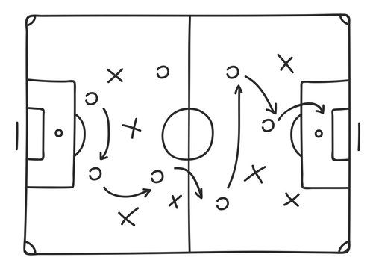
Understand tactics used by others. We do not recommend you use them, but here is the list so you can recognise them
Flinching
The better offer
Referring to a high authority
Good cop/Bad cop routine
Using silence
“The Columbo” – one more thing…
Being belligerent/ Stonewalling
Urgency ‘But I need it now!’

Slide 47
Knowing how to deal with Objections and Tactics…
5 simple tricks which will help you be more effective.
3
5
Talk less
4
Be patient and show it
Keep your cool
1
Listen more
Show empathy
2

Slide 48
Knowing and maintaining your sources of negotiation power
Negotiating power generally comes from one of three sources:
Having clearly defined aims and a desired outcome from the outset
Role power
Psychological power
When preparing for negotiation or dialogue with a powerful counterpart, (for example a large fresh-produce buyer) try to increase your own sense of power on as many of these levels as possible. Again, this emphasises the need to be prepared going into your discussion.
Above all believe in yourself!

Slide 49

Sales Techniques…
Ok so you have done your preparation for your sales meeting…now we are going to equip you with four simple but practical tips that can help to BOOST your MINDSET and hopefully improve the sales outcomes when you need.
Keep reading!
Source

Slide 50

1
Reframe
Breathe and focus on why you are doing this
If you are feeling daunted or worried at the prospect of a meeting to sell or negotiate?
Reframe this anxiety as excitement.
This simple positive mindset shift switches anxiety into a forward-thinking state, boosting your outlook and confidence.
Source

Slide 51
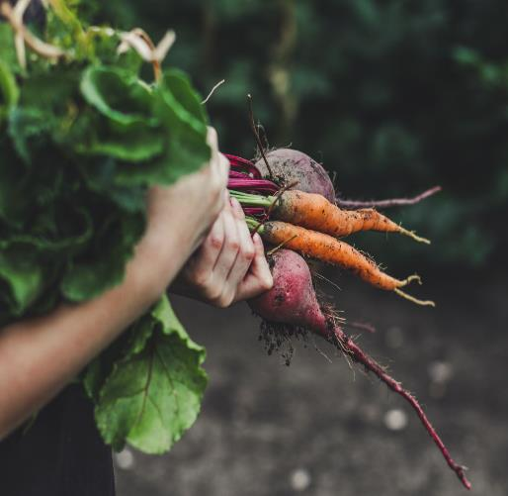
Anchor - Try that first offer
2
Dangle that carrot so to speak ☺
Studies by psychologists have shown that the negotiator making the first offer is likely to sway the discussion in their favour. First offers tend to serve as powerful anchors.
Consider making the first offer to get the sale moving.
Source

Slide 52

Apply the power of silence
3
Silence can be more powerful than a protest
In sales, as in any discussion, we tend to rush in to fill awkward silences
After your counterpart speaks, allow a few moments of silence to settle, this gives you time to fully absorb what was just said. “Silence gives you the ability to dampen your instincts for self-advocacy and amplify your instinct to listen,” according to Harvard Business School Professor Guhan Subramanian
Source

Slide 53

4
Ask for Advice
You get advice and you strengthen your relationship- win win!
In a recent study, buyers rated partners who asked them for advice to be more competent than those who didn’t ask for advice/
When we ask for advice, we flatter the advisor and boost their self-confidence, the researchers found. So, consider taking opportunities to ask your counterpart for advice when you truly need it.
Source

Slide 54
Well done!!!
You have just completed Module 5. We hope you benefitted from deeper learning about the importance of your value proposition as the foundation for sales and creating good sales techniques in order to develop your smallholding as a viable enterprise.
Now it is time for our final Module 6, where our learning focus moves to Technology & Your Smallholder Business.
www.small-holders.eu

